Slide 1

Implementation and Testing of the Node Replication Scheme of the FT4FTT Architecture
Màster Universitari Enginyeria Informàtica (MINF)
Author
Alberto Ballesteros
Supervisors
Julián Proenza
Manuel Barranco
Universitat de les Illes Balears
Miércoles, 5 de Octubre 2016

Slide 2
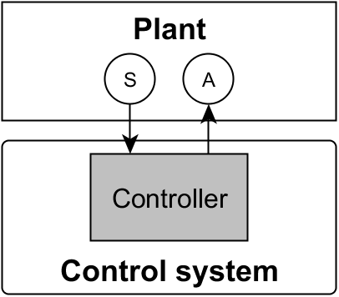
Introduction
Control System: Control or regulate the behaviour of another system, the plant. Sense, Control and Actuate.

Slide 3
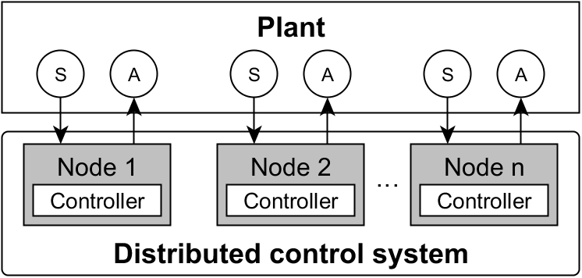
Introduction
Distributed Control System: Control performed by several control nodes.

Slide 4
Introduction
The FT4FTT (Fault Tolerance for Flexible Time-Triggered Ethernet) project aims at providing a complete architecture that supports distributed control systems that are:
Real-time → Have deadlines
Highly-reliable → Have low probability of failure
Adaptive → Have to work in changing environments

Slide 5
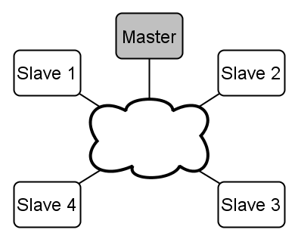
Introduction
FT4FTT is constructed on top of the
Flexible Time-Triggered (FTT)
Master/multi-slave comm. model
Slaves are regular nodes
The master manages the comm.

Slide 6
Introduction
FT4FTT is constructed on top of the
Flexible Time-Triggered (FTT)
Communication is divided into fixed-duration slots called Elementary Cycles
The objective of the TM is twofold:
Synchronizes the slaves
Conveys the EC-schedule
Elementary Cycle_{i}
Elementary Cycle_{i+1}
Elementary Cycle_{i+2}
···

Slide 7
Introduction
FT4FTT is constructed on top of the
Flexible Time-Triggered (FTT)
Communication is divided into fixed-duration slots called Elementary Cycles
The objective of the TM is twofold:
Synchronizes the slaves
Conveys the EC-schedule
Elementary Cycle_{i}
Elementary Cycle_{i+1}
Elementary Cycle_{i+2}
TM
···

Slide 8
Introduction
FT4FTT is constructed on top of the
Flexible Time-Triggered (FTT)
Communication is divided into fixed-duration slots called Elementary Cycles
The objective of the TM is twofold:
Synchronizes the slaves
Conveys the EC-schedule
Elementary Cycle_{i}
Elementary Cycle_{i+1}
Elementary Cycle_{i+2}
TM
M
M
M
···

Slide 9
Introduction
FT4FTT is constructed on top of the
Flexible Time-Triggered (FTT)
Communication is divided into fixed-duration slots called Elementary Cycles
The objective of the TM is twofold:
Synchronizes the slaves
Conveys the EC-schedule
Elementary Cycle_{i}
Elementary Cycle_{i+1}
Elementary Cycle_{i+2}
TM
M
M
M
TM
M
M
TM
M
M
M
···

Slide 10
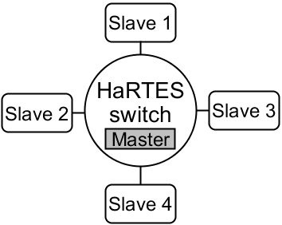
Introduction
FT4FTT is constructed on top of the
Flexible Time-Triggered (FTT)
HaRTES (Hard Real-Time Ethernet Switching)
Switched-Ethernet
Custom switch
Master embedded

Slide 11
Introduction
FT4FTT is constructed on top of the
Flexible Time-Triggered (FTT)
FTT is tailored for real-time adaptive systems
Was not designed having high-reliability in mind
HaRTES (Hard Real-Time Ethernet Switching)
Switched-Ethernet
Custom switch
Master embedded

Slide 12
Introduction
Vulnerable to faults
affecting the network
Vulnerable to faults
affecting the nodes

Slide 13
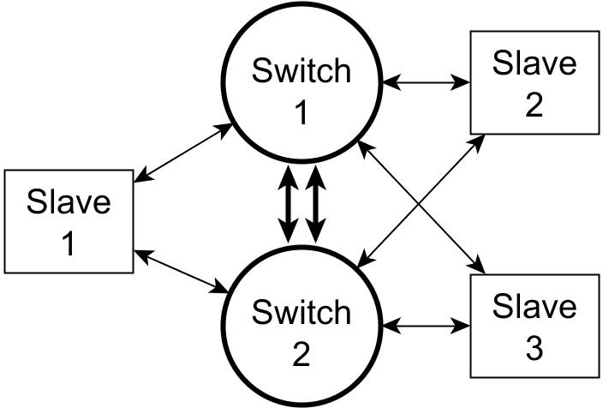
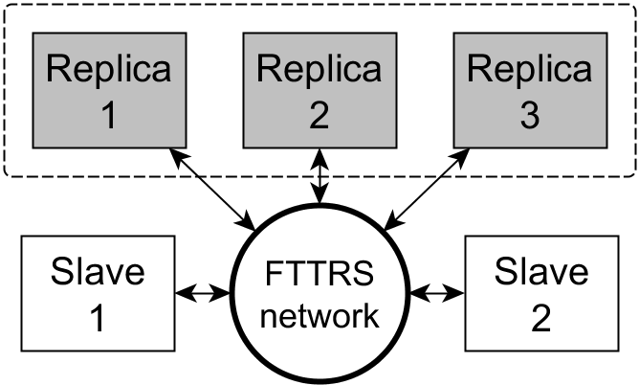
Introduction
Fault tolerance to faults
affecting the network
Fault tolerance to faults
affecting the nodes
Flexible Time-Triggered Replicated Star (FTTRS)
Node Replication scheme

Slide 14
Introduction
Fault tolerance to faults
affecting the network
Fault tolerance to faults
affecting the nodes
Flexible Time-Triggered Replicated Star (FTTRS)
Node Replication scheme

Slide 15
Introduction
GOALS OF THIS TFM
Implement the node replication scheme devised to tolerate faults in the nodes
Extend the FT4FTT prototype to test this scheme when faults do occur
Verify the implementation, validate the scheme

Slide 16
Outline
Design of the node replication scheme
Implementation
Testbed setup
Testing
Conclusions
Publications and other works

Slide 17
Outline
Design of the node replication scheme
Implementation
Testbed setup
Testing
Conclusions
Publications and other works

Slide 18
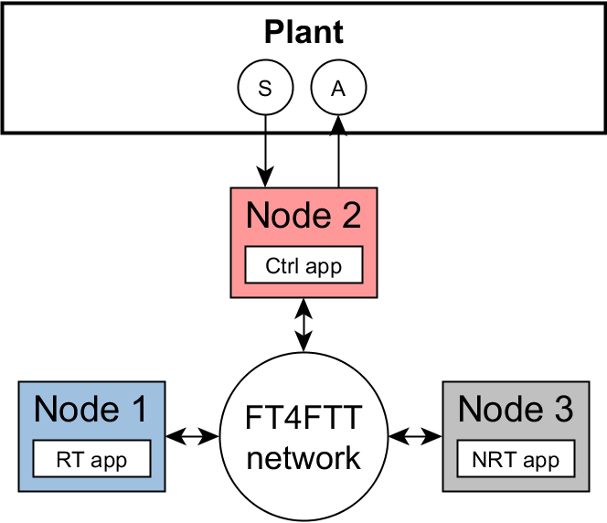
Design of the NR scheme
Active replication – Physical replication

Slide 19
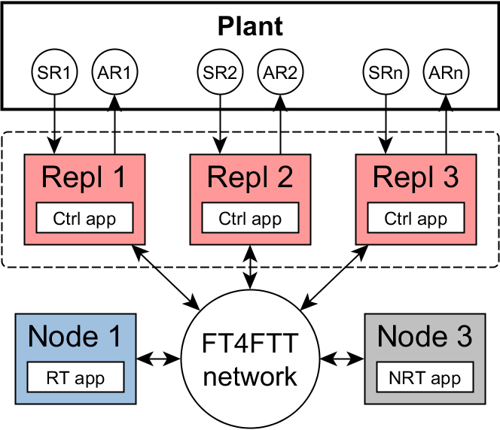
Design of the NR scheme
Active replication – Physical replication

Slide 20
Design of the NR scheme
Active replication – Majority voting
Sense
Ctrl.
Act.

Slide 21
Design of the NR scheme
Active replication – Majority voting
Sense
Exch. Sense
Vote Sense
Ctrl.
Exch. Act.
Vote Act.
Act.

Slide 22
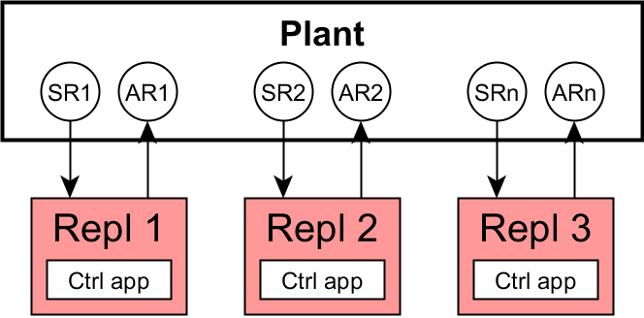
Design of the NR scheme
Active replication – Majority voting
Sense
Exch. Sense
Vote Sense
Ctrl.
Exch. Act.
Vote Act.
Act.

Slide 23
Design of the NR scheme
Active replication – Majority voting
Sense
Exch. Sense
Vote Sense
Ctrl.
Exch. Act.
Vote Act.
Act.
A
A
B

Slide 24
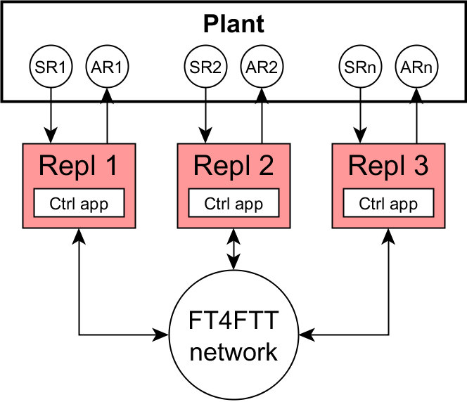
Design of the NR scheme
Active replication – Majority voting
Sense
Exch. Sense
Vote Sense
Ctrl.
Exch. Act.
Vote Act.
Act.
A
A
B

Slide 25

Design of the NR scheme
Active replication – Majority voting
Sense
Exch. Sense
Vote Sense
Ctrl.
Exch. Act.
Vote Act.
Act.
AAB
AAB
AAB

Slide 26
Design of the NR scheme
Active replication – Majority voting
Sense
Exch. Sense
Vote Sense
Ctrl.
Exch. Act.
Vote Act.
Act.
A
A
A
Consensus

Slide 27
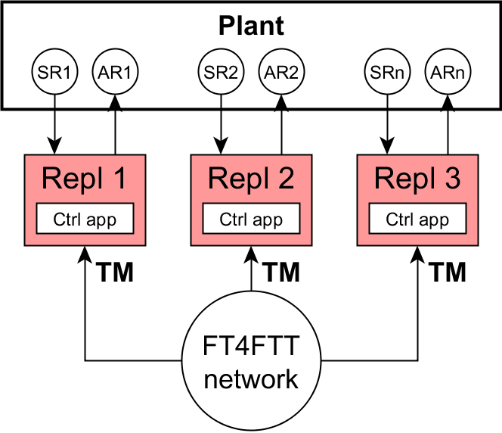
Design of the NR scheme
Coordinated triggering of phases
Sense
Exch. Sense
Vote Sense
Ctrl.
Exch. Act.
Vote Act.
Act.

Slide 28
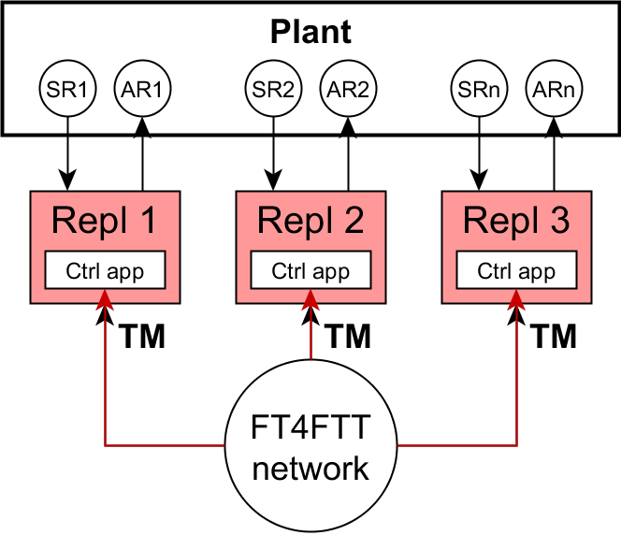
Design of the NR scheme
Coordinated triggering of phases
Sense
Exch. Sense
Vote Sense
Ctrl.
Exch. Act.
Vote Act.
Act.
seqno
seqno
seqno

Slide 29
Design of the NR scheme
Benefits
Tolerance to permanent faults
Tolerance to temporary faults

Slide 30
Design of the NR scheme
Benefits
Tolerance to permanent faults
Tolerance to temporary faults
✔

Slide 31
Design of the NR scheme
Benefits
Tolerance to permanent faults
Tolerance to temporary faults
✔

Slide 32
Design of the NR scheme
Benefits
Tolerance to permanent faults
Tolerance to temporary faults
✔

Slide 33
Design of the NR scheme
Benefits
Tolerance to permanent faults
Tolerance to temporary faults

Slide 34
Design of the NR scheme
Benefits
Tolerance to permanent faults
Tolerance to temporary faults
✔

Slide 35
Design of the NR scheme
Benefits
Tolerance to permanent faults
Tolerance to temporary faults
✔
✔
If replica 3 can vote
it can recover

Slide 36
Design of the NR scheme
Some temporary faults
can make the replica lost from then on

Slide 37
Design of the NR scheme
Some temporary faults
Communication capabilities
Internals of the replica

Slide 38
Design of the NR scheme
Some temporary faults
Communication capabilities
Internals of the replica
?
Loss of coordination
communication level and/or application level
?

Slide 39
Design of the NR scheme
Some temporary faults
Communication capabilities
Internals of the replica
Loss of coordination
communication level and/or application level
Replica permanently disabled

Slide 40
Design of the NR scheme
Some temporary faults
Communication capabilities
Internals of the replica
Temporary faults are more probable than permanent ones
if we do not prevent this attrition of the redundancy
we are not taking full advantage of the redundancy investment
Loss of coordination
communication level and/or application level
Replica permanently disabled

Slide 41
Design of the NR scheme
Diagnosis and reintegration of discoordinated replicas
Diagnose discoordinated nodes
Reintegrate them
As soon as possible

Slide 42
Design of the NR scheme
Diagnosis and reintegration of discoordinated replicas
TM resynchronization
Voting Reintegration Point
Communication Error Counter
Discrepancy Error Counter
You Are Alive (YAA) watchdog

Slide 43
Design of the NR scheme
Diagnosis and reintegration of discoordinated replicas
TM resynchronization
Voting Reintegration Point
Communication Error Counter
Discrepancy Error Counter
You Are Alive (YAA) watchdog

Slide 44
Design of the NR scheme
Diagnosis and reintegration of discoordinated replicas
Voting Reintegration Point
Operational
status

Slide 45
Design of the NR scheme
Diagnosis and reintegration of discoordinated replicas
Voting Reintegration Point
Operational
status
Sense
Exch. Sense
Vote Sense
Ctrl.
Exch. Act.
Vote Act.
Act.

Slide 46
Design of the NR scheme
Diagnosis and reintegration of discoordinated replicas
Voting Reintegration Point
Operational
status
Sense
Exch. Sense
Vote Sense
Ctrl.
Exch. Act.
Vote Act.
Act.
Operational status
Operational status

Slide 47
Outline
Design of the node replication scheme
Implementation
Testbed setup
Testing
Conclusions
Publications and other works

Slide 48
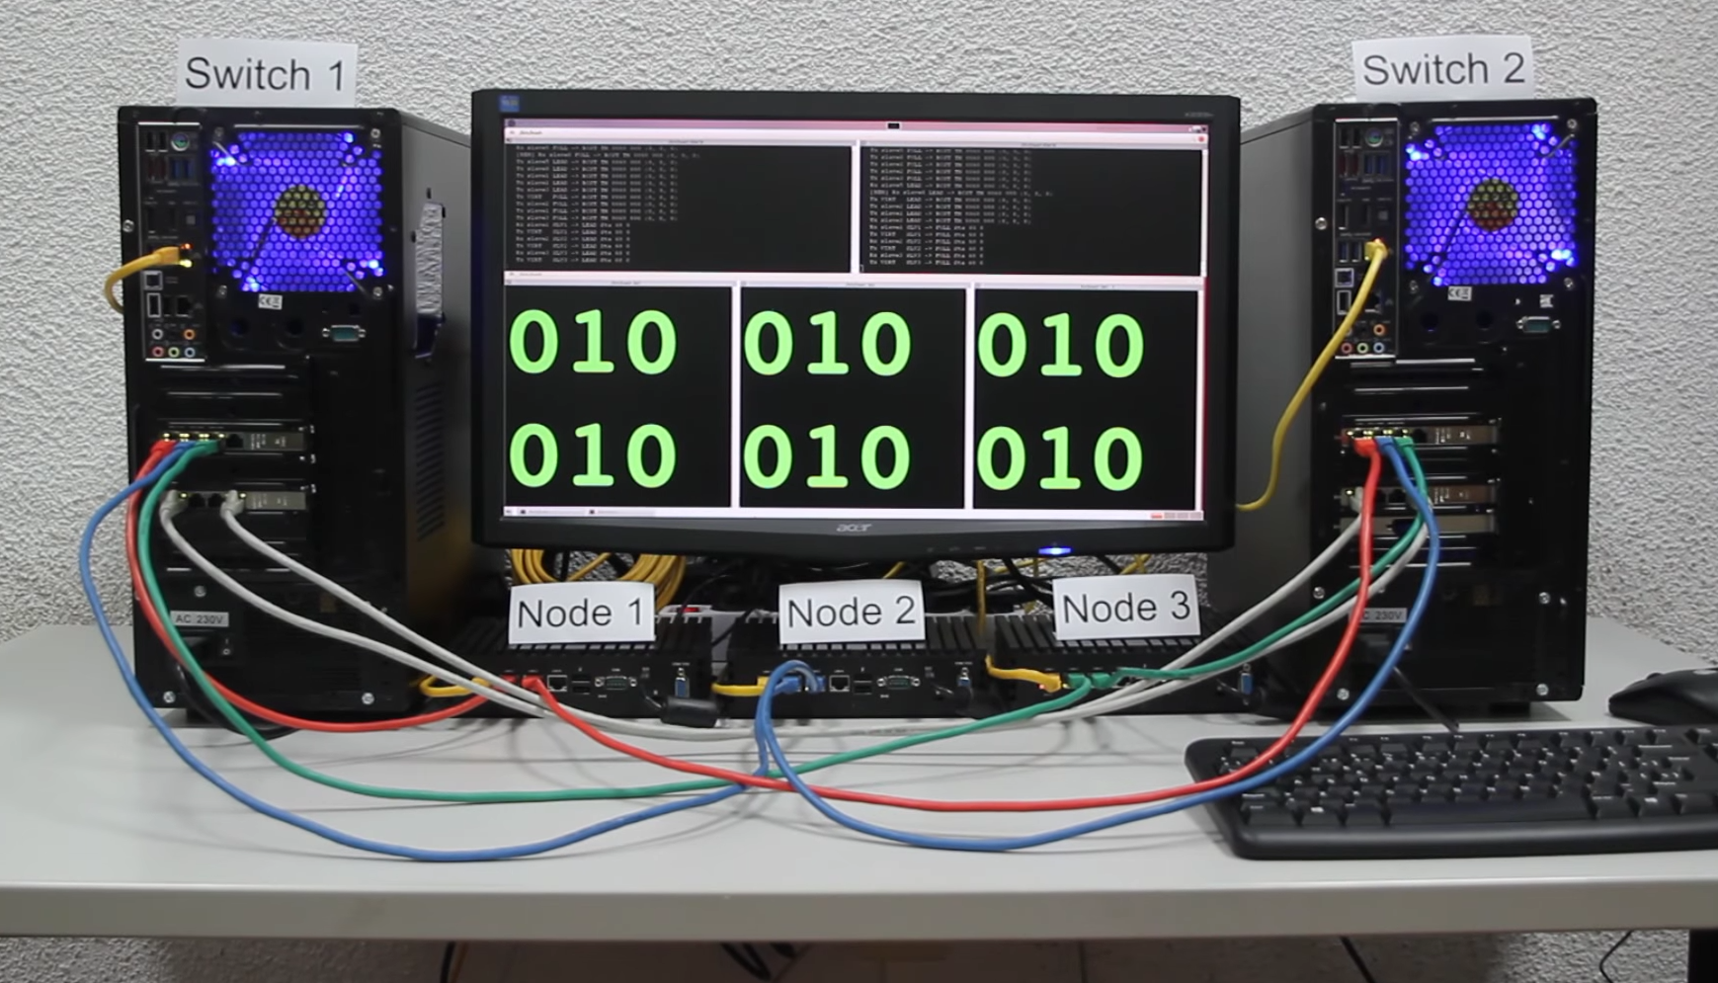
Implementation
Extend the existing FT4FTT prototype

Slide 49
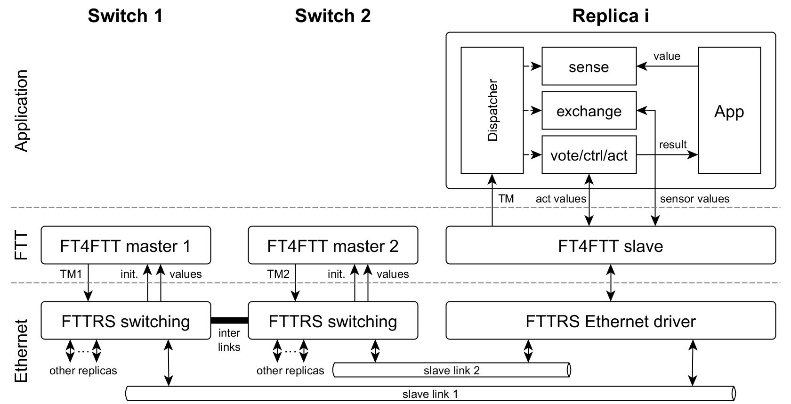
Implementation
Extend the existing FT4FTT prototype

Slide 50
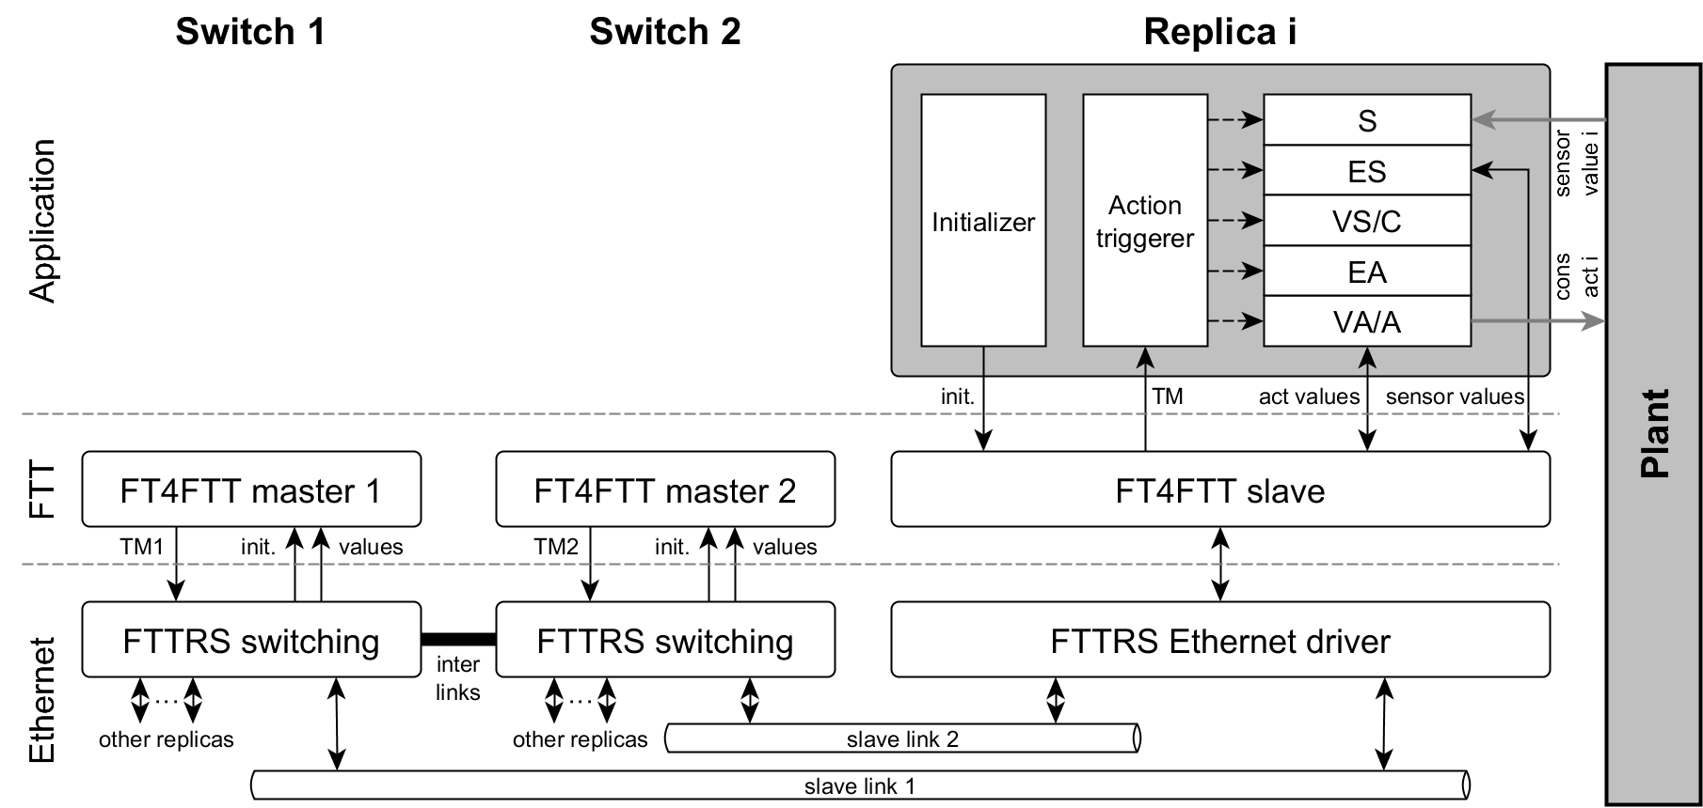
Implementation
Extend the existing FT4FTT prototype

Slide 51
Implementation
Extend the existing FT4FTT prototype

Slide 52
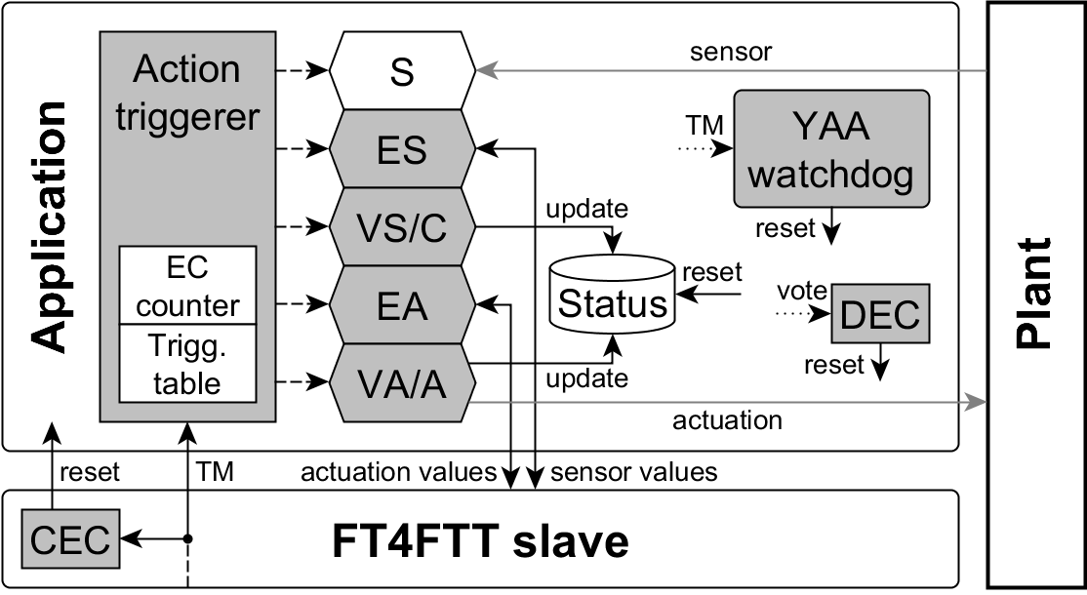
Implementation
Extend the existing FT4FTT prototype

Slide 53
Implementation
Extend the existing FT4FTT prototype

Slide 54
Implementation
Extend the existing FT4FTT prototype

Slide 55
Outline
Design of the node replication scheme
Implementation
Testbed setup
Testing
Conclusions
Publications and other works

Slide 56
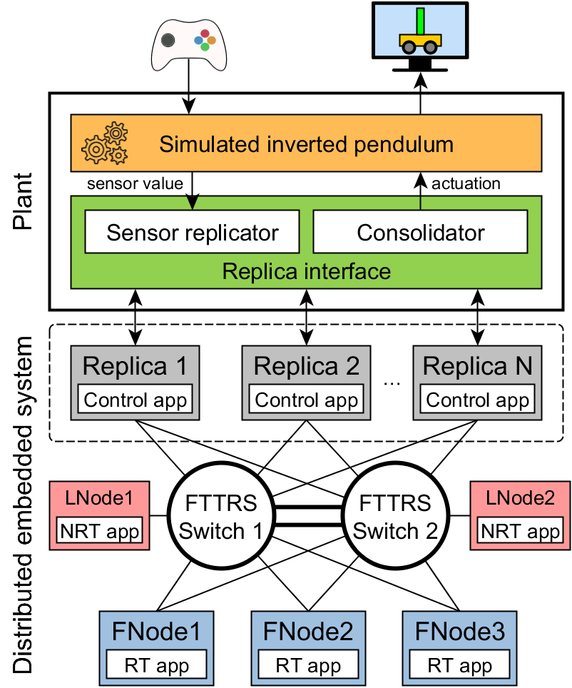
Testbed setup
Distributed System
Control application (RT + reliable)
Periodic exchange (RT + flex)
Video stream (non-RT)
Simulated plant
(Final year project collaboration)
Hardware-in-the-loop technique
Inverted pendulum in Simulink
Replica interface

Slide 57
Testbed setup
Distributed System
Control application (RT + reliable)
Periodic exchange (RT + flex)
Video stream (non-RT)
Simulated plant
(Final year project collaboration)
Hardware-in-the-loop technique
Inverted pendulum in Simulink
Replica interface

Slide 58
Testbed setup
Distributed System
Control application (RT + reliable)
Periodic exchange (RT + flex)
Video stream (non-RT)
Simulated plant
(Final year project collaboration)
Hardware-in-the-loop technique
Inverted pendulum in Simulink
Replica interface

Slide 59
Testbed setup
Distributed System
Control application (RT + reliable)
Periodic exchange (RT + flex)
Video stream (non-RT)
Simulated plant
(Final year project collaboration)
Hardware-in-the-loop technique
Inverted pendulum in Simulink
Replica interface

Slide 60
Testbed setup
Distributed System
Control application (RT + reliable)
Periodic exchange (RT + flex)
Video stream (non-RT)
Simulated plant
(Final year project collaboration)
Hardware-in-the-loop technique
Inverted pendulum in Simulink
Replica interface

Slide 61
Outline
Design of the node replication scheme
Implementation
Testbed setup
Testing
Conclusions
Publications and other works

Slide 62
Testing
Video demo

Slide 63
Testing
Partial testing
Verify the implementation of each mechanism independently
Complete testing
Verify complete implementation and integration
Validate the mechanisms
Obtain preliminary measurements of the reintegration time

Slide 64
Testing
Partial testing
Verify the implementation of each mechanism independently
Complete testing
Verify complete implementation and integration
Validate the mechanisms
Obtain preliminary measurements of the reintegration time
Tolerance to permanent faults
Tolerance to temporary faults

Slide 65
Testing
Tolerance to permanent faults
Provoke crashes in the switches, links and nodes
All working combinations (162 scenarios)

Slide 66
Testing
Tolerance to permanent faults
Provoke crashes in the switches, links and nodes
All working combinations (162 scenarios)

Slide 67
Testing
Tolerance to permanent faults
Provoke crashes in the switches, links and nodes
All working combinations (162 scenarios)

Slide 68
Testing
Tolerance to permanent faults
Provoke crashes in the switches, links and nodes
All working combinations (162 scenarios)

Slide 69
Testing
Tolerance to temporary faults
5 tests involving one replica and each phase (19 scenarios)
Provoke message omissions
Provoke memory corruption

Slide 70
Testing
Tolerance to temporary faults
5 tests involving one replica and each phase (19 scenarios)
Provoke message omissions
Provoke memory corruption

Slide 71
Testing
Results
The system was able to transparently tolerate the faults
The system always operate normally
No apparent disturbances in the control of the plant

Slide 72
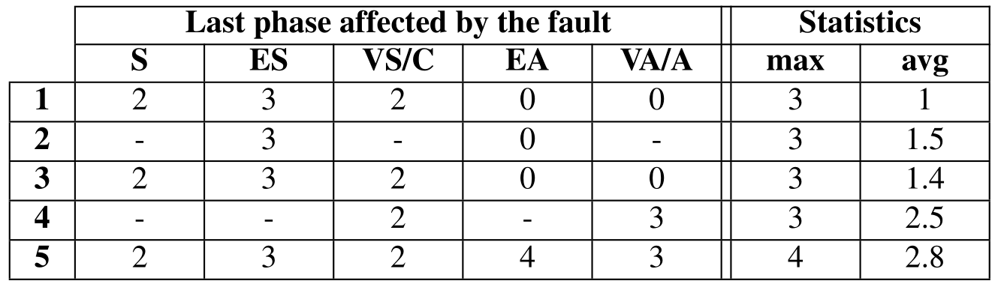
Testing
Results
Measurements of the reintegration time (in number of ECs)
Time until next successful voting

Slide 73
Testing
Results
Measurements of the reintegration time (in number of ECs)
Time until next successful voting

Slide 74
Outline
Design of the node replication scheme
Implementation
Testbed setup
Testing
Conclusions
Publications and other works

Slide 75
Conclusions
We achieved the goal, we implemented and tested the replication scheme designed for the FT4FTT architecture:
Mechanisms devised to add redundancy to the nodes
Diagnose and reintegrate discoordinated replicas
For this we extended the previous FT4FTT prototype by adding new functionalities mostly at the application level
One relevant contribution is the development of the experimental setup, using the hardware-in-the-loop technique, used to test all these mechanisms.

Slide 76
Outline
Design of the node replication scheme
Implementation
Testbed setup
Testing
Conclusions
Publications and other works

Slide 77
Publications
A. Ballesteros, S. Derasevic, D. Gessner, F. Font, M. Barranco and J. Proenza
First Implementation and Test of a Node Replication Scheme on top of the Flexible Time-Triggered Replicated Star for Ethernet
12th IEEE World Conf. on Factory Comm. Systems (WFCS), 2016.
Best Work-in-Progress Award
A. Ballesteros, S. Derasevic, M. Barranco and J. Proenza
First Implementation and Test of Reintegration Mechanisms for Node Replicas in the FT4FTT Architecture
21st IEEE Int. Conf. on Emerging Tech. and Factory Autom. (ETFA), 2016.

Slide 78
Other works
Maties Melià. Master thesis supervised by J. Proenza and A. Ballesteros.
Implementació i validació de mecanismes per a l’intercanvi consistent d’informació entre nodes d’un sistema encastat distribuït basat en HaRTES.
Andreu Adrover. Final-year project supervised by A. Ballesteros and J. Proenza.
Infraestructura d’injecció de fallades per a Ethernet amb funcions específiques per a FTT.
Adel Zendouh. Bachelor thesis supervised by A. Ballesteros and M. Barranco.
Dependable Distributed infrastructures for monitoring and automation in complex emerging applications.
Francisca Font. Ongoing final-year project supervised by A. Ballesteros and J. Proenza.
Simulador gráfico de la planta de un sistema de control según la técnica hardware-in-the-loop.

Slide 79
Implementation and Testing of the Node Replication Scheme of the FT4FTT Architecture
Màster Universitari Enginyeria Informàtica (MINF)
Author
Alberto Ballesteros
Supervisors
Julián Proenza
Manuel Barranco
Universitat de les Illes Balears
Miércoles, 5 de Octubre 2016

